Slide 1

Introduction to
Iva Čukić, PhD
Centre for Dementia Prevention
March, 2018

Slide 2
Cou se outline
Week 1:
The R/R Studio environment
Basic operations and logic
Week 2:
“Cleaning” the variables
Descriptive statistics
Week 3:
Testing group differences: t-test, anova, chi-square
Week 4:
Predicting the outcome: linear and logistic regression

Slide 3
What is R anyway?
Software environment for statistical computing and data visualisation, free under the GNU General Public Licence
Extension of the S programming language, created in 1976 at Bell Labs
R was created by Ross Ihaka and Robert Gentleman in 1992, at the University of Aukland, NZ
It is currently developed and maintained by the R Development Core Team at https://www.r-project.org/

Slide 4
Installing R and R Studio
Base package:
https://www.r-project.org/ (Current version: 3.4.3. Kite Eating Tree)
Additional packages:
Comprehensive R Archive Network (CRAN)
User friendly software:
R Studio https://www.rstudio.com/ (Current version: 1.1.423)

Slide 5
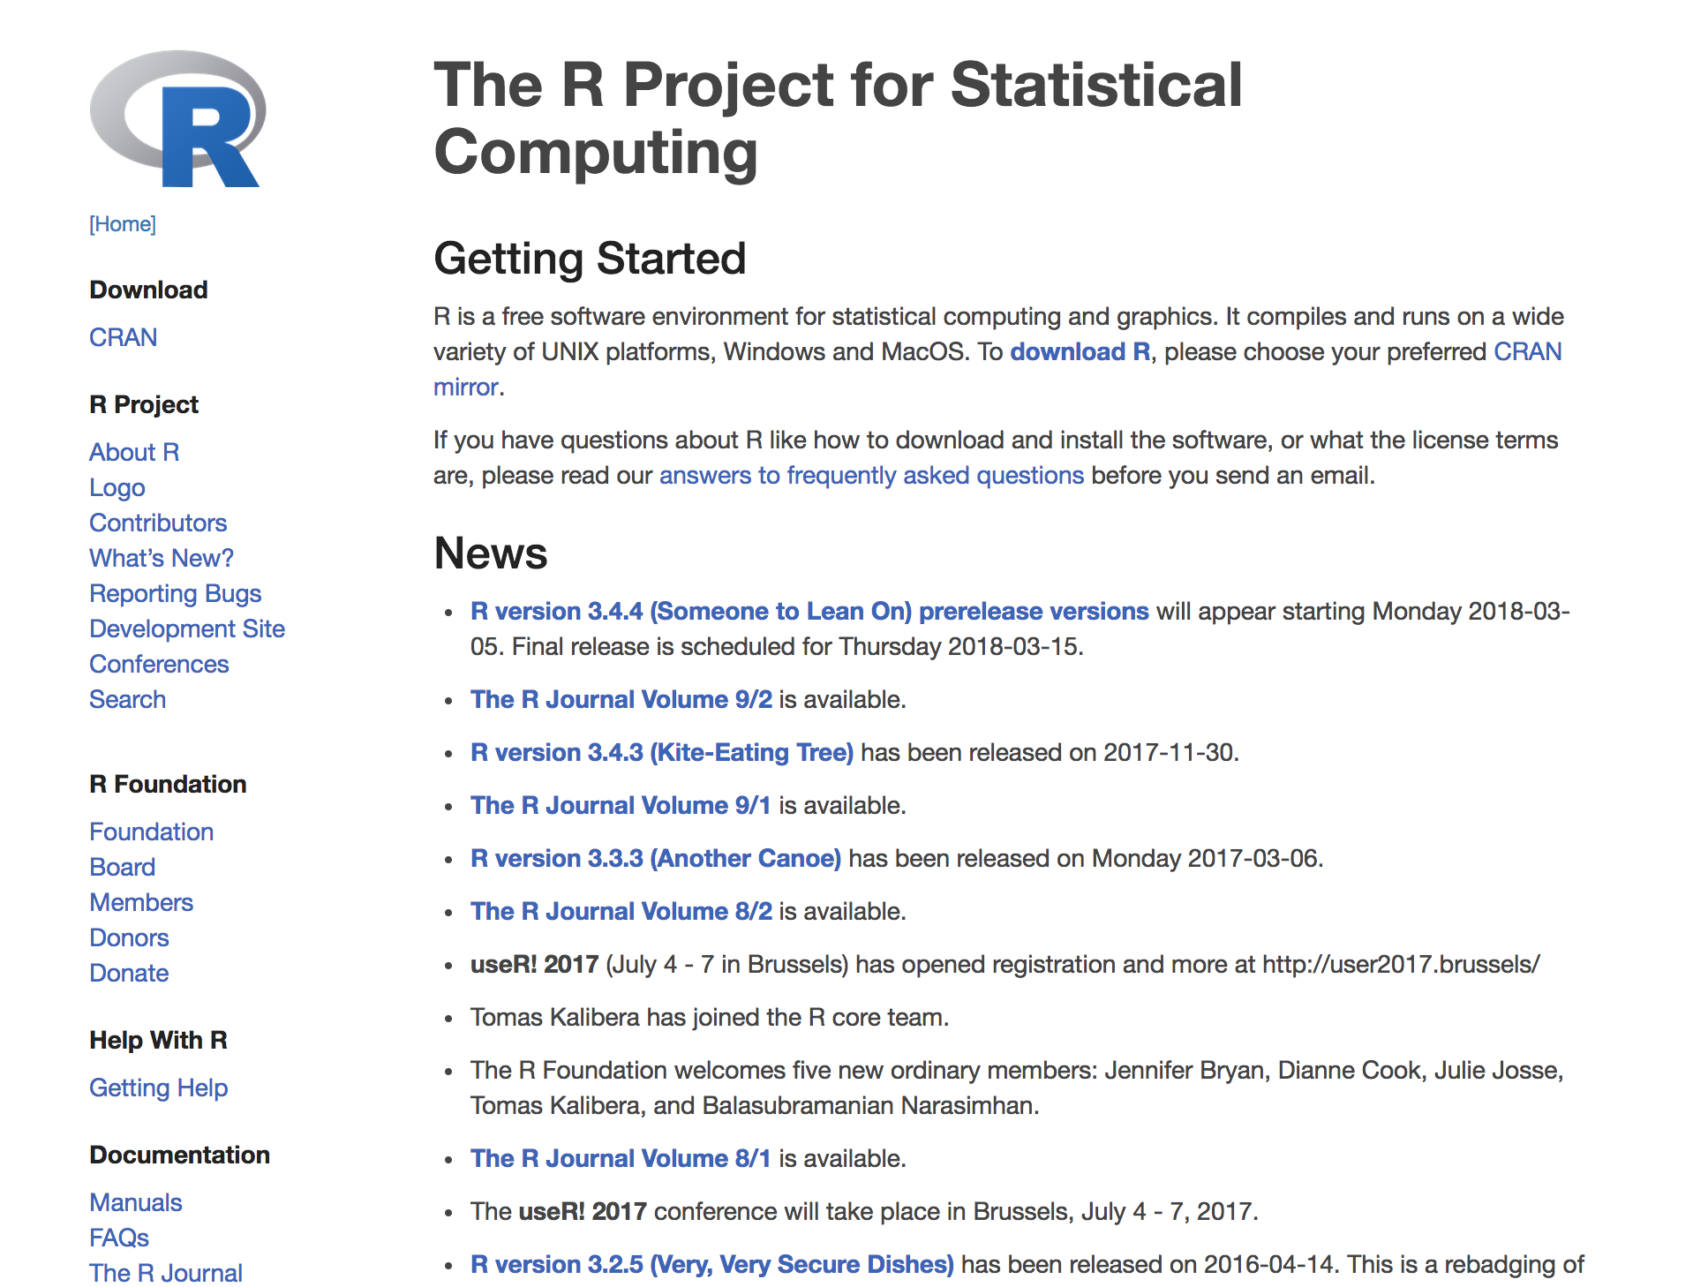

Slide 7
What does R look like?
>

Slide 8
R Studio to the rescue! (Somewhat)

Slide 9
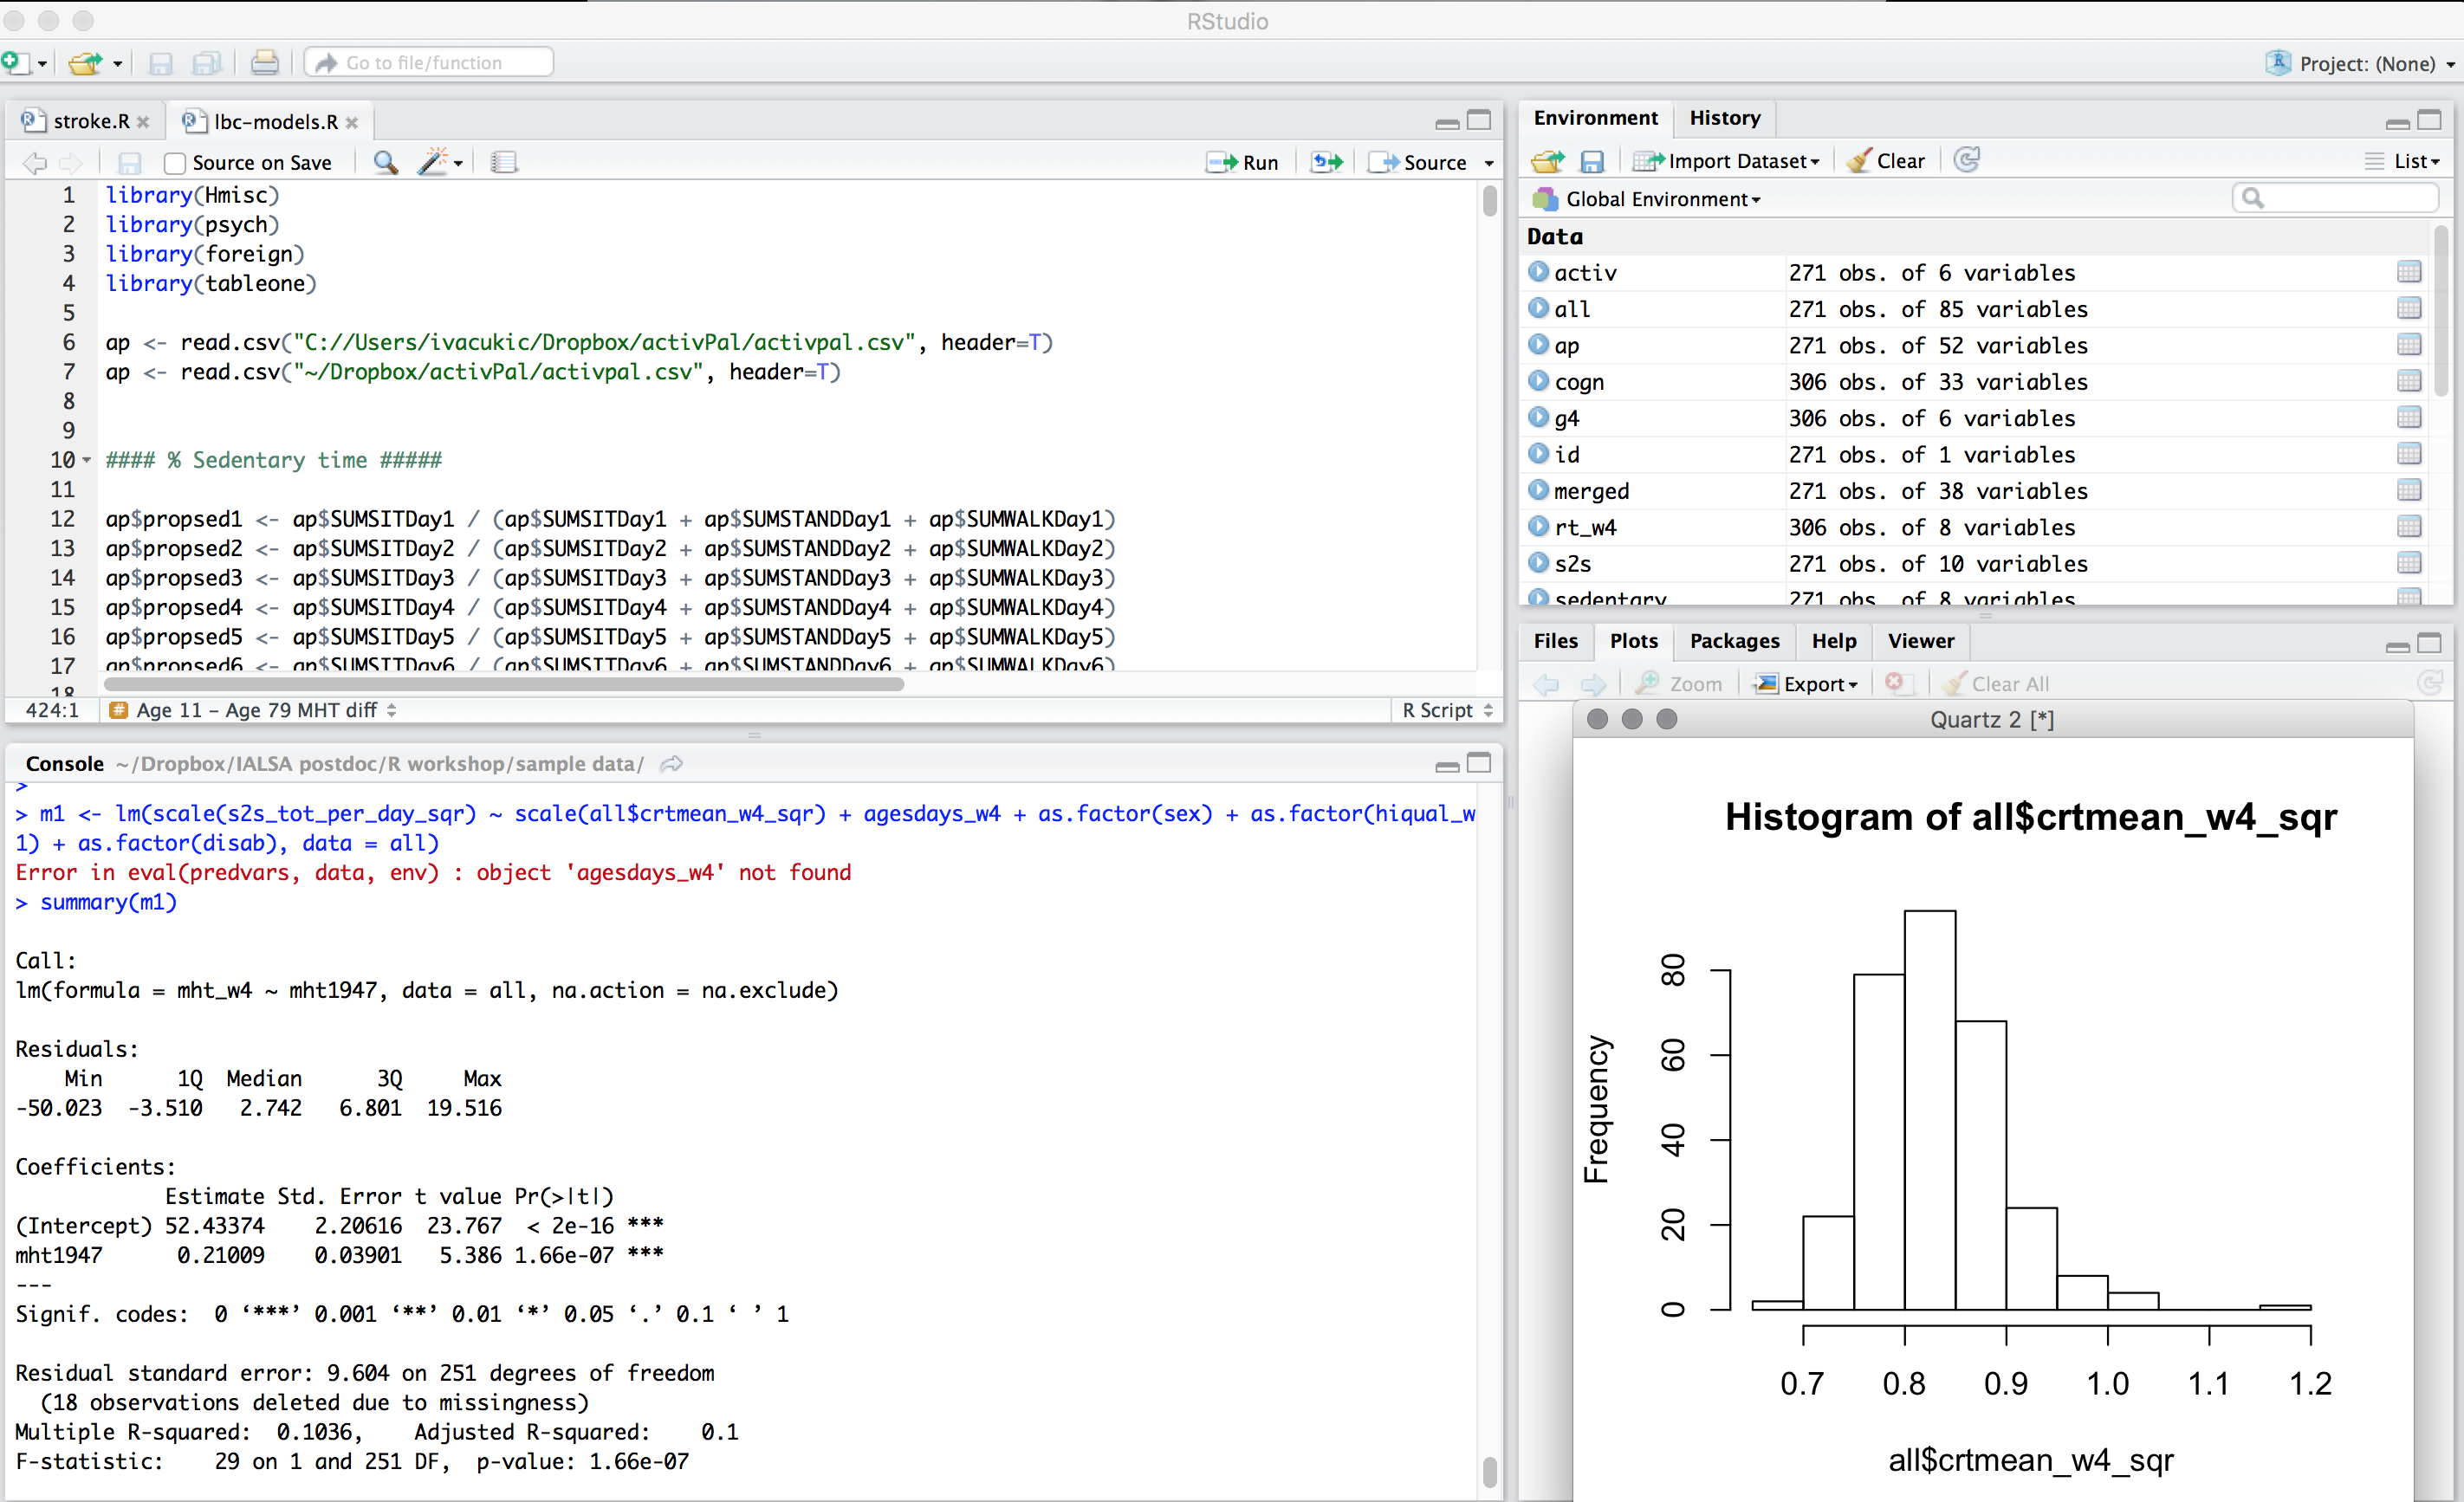

Slide 10
Structure
Scripts
text file where all your code is written
Data
spreadsheet like matrix with variables and participants
Console
where we execute our commands and see outputs
Tons more

Slide 11
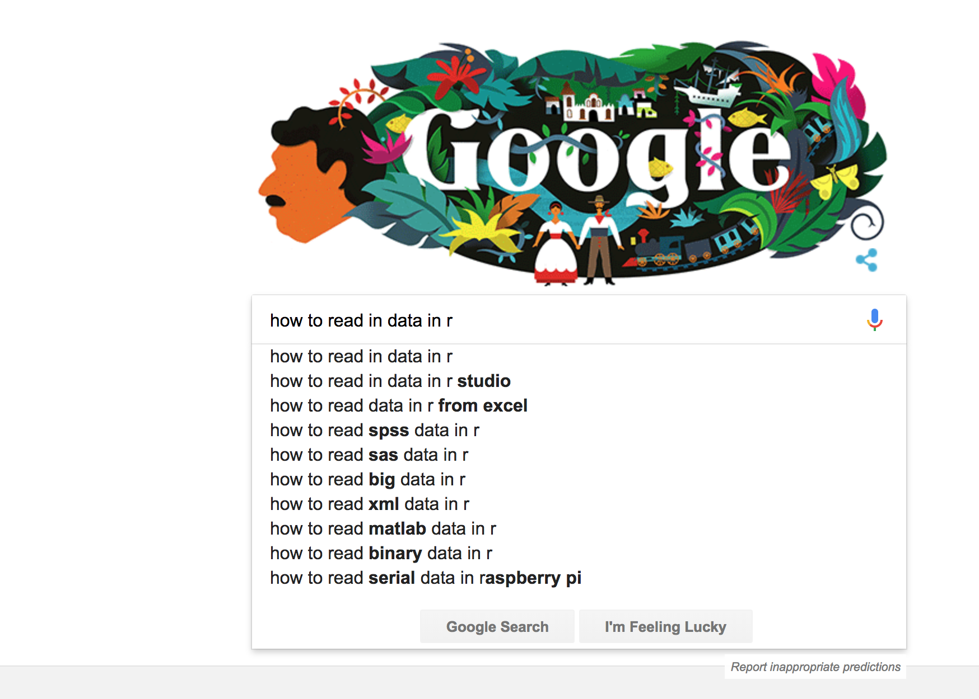
Your best friend

Slide 12
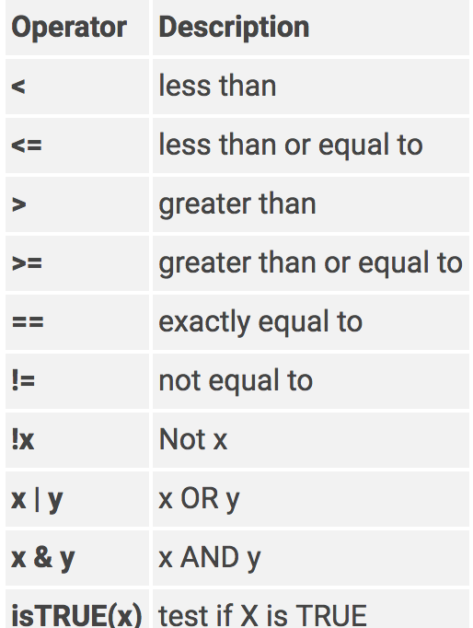
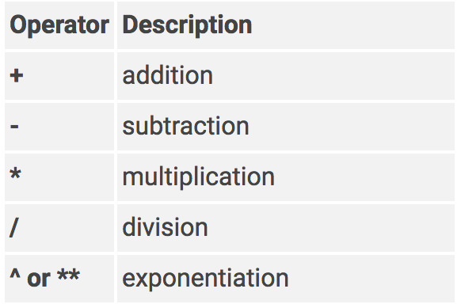
Operators
Logical
Arithmetic

Slide 13
Download practice data set
Download here:
https://github.com/ivacukic/Introduction-to-R
Adapted from https://vincentarelbundock.github.io/Rdatasets/datasets.html

Slide 14
Resources
Edinburgh R Meetup
http://edinbr.org/
R Bloggers
https://www.r-bloggers.com/
Stack Overflow
https://stackoverflow.com/
John Hopkins University Coursera Course
https://www.coursera.org/learn/r-programming
Data Camp Course
https://www.datacamp.com/courses/free-introduction-to-r

